Slide 1


Songs Analysis with Power BI
Presented by : MD Sozon
Batch : MIP-DA-10

Slide 2
Problem Statement
This internship project aims to conduct a comprehensive analysis of YouTube songs data using Power BI.
The dataset contains key attributes such as video ID, channel title, title, description, tags, published date, view count, like count, favorite count, comment count, video duration, video definition, and caption details.
The goal is to utilize Power BI to create insightful visualizations and reports that provide a deeper understanding of YouTube songs' performance, popularity, and user engagement.
The analysis aims to uncover trends, preferences, and patterns in the data to aid content creators and stakeholders in optimizing their YouTube song content.

Slide 3
Project Objectives :
1. Data Cleaning and Preparation:
- Clean and preprocess the dataset, handling missing values or outliers.
- Convert relevant columns to appropriate data types.
2. Exploratory Data Analysis (EDA):
- Explore patterns and distributions in view counts, like counts, and comments.
- Identify trends in the popularity and engagement of YouTube song videos.
3. Content and Channel Analysis:
- Analyze the distribution of videos across different channels.
- Identify popular tags and their correlation with view counts.

Slide 4
Project Objectives :
4. Temporal Trends:
- Explore how YouTube song video metrics vary over time.
- Identify peak publishing times and their impact on engagement.
5. User Engagement Insights:
- Investigate relationships between likes, comments, and views.
- Identify factors influencing user engagement with YouTube song videos.

Slide 5
The dataset includes the following columns:
1. video_id
2. channelTitle
3. title
4. description 5. Tags 6. PublishedAt 7. ViewCount 8. likeCount
9. favoriteCount
10. CommentCount 11. duration
12. definition
13. caption
Dataset:

Slide 6
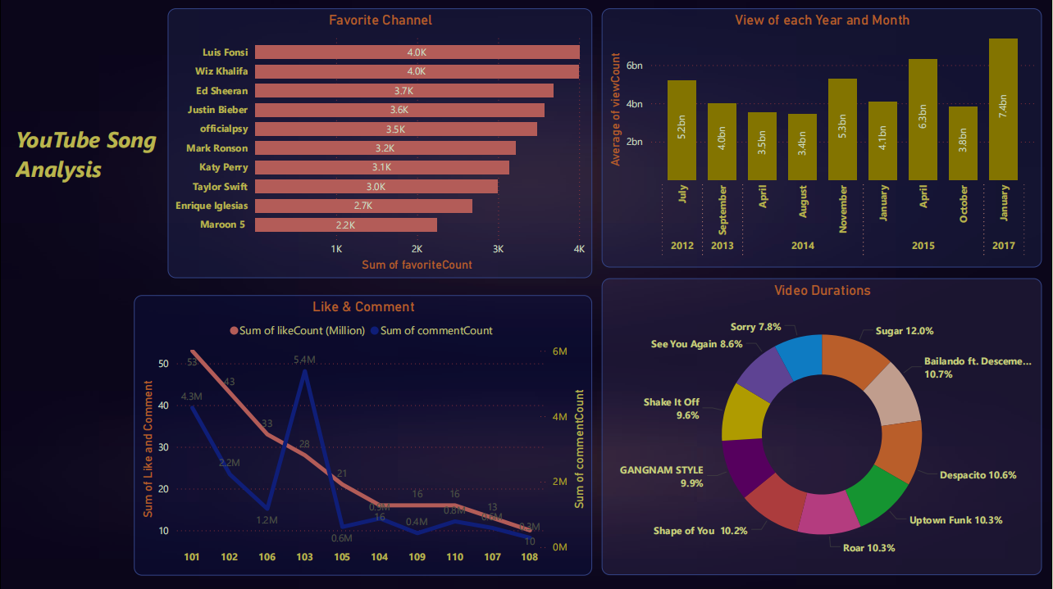

Slide 7
Thank You

